Slide 1


Information Session
Minors and projects

Slide 2


A fully modular education program
🎓
Your Master curriculum
🎓
Your PhD curriculum
➡️
Optional courses
Optional courses
Thesis
DS4H options
➡️
Mandatory disciplinary courses
➡️
➡️
"Heures de formation"
Minors
Minors
Disciplinary options
➡️
DS4H options
Projects
Minors
Projects

Slide 3
DS4H Minors
Additional courses to explore new disciplines alongside your major.
Business
Digital strategy
Website creation workshop
Technical
Agentic software development
AI: Introduction to deep learning
IoT: Connected objects
Quantum computing and networking
Quantum technologies
Sensor and network devices
Digital Culture
Anthropology and ethics of technics
Digitalization and environment: friend or foe?
Technological challenges in the IoT domain
Emotion and AI
Soft Skills
Innovation and creativity
Innovation and design thinking
Introduction to scientific research
Organize your activity in project mode
🗝️
🗝️
Mostly on Thurday mornings
No
or low prerequisites
For Master and PhD
One per semester
In English​

Slide 4
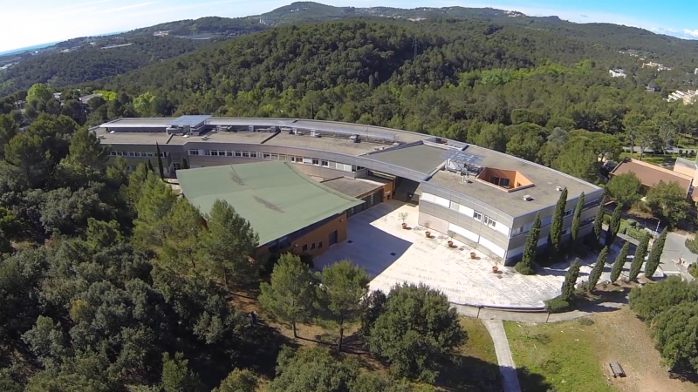
DS4H Minors
Check the content and schedule of each minor on the website!
➡️
https://ds4h.univ-cotedazur.eu/minors
📍SophiaTech campus​
Agentic software development​
AI: Introduction to deep learning​
Digitalization and environment: friend or foe? ​
Introduction to scientific research​
Technological challenges in the IoT domain
Minors condensed into one week: workshop format!
📅 January 11–15, 2027
Organize your activity in project mode
Quantum computing and networking
+ Online!

Slide 5
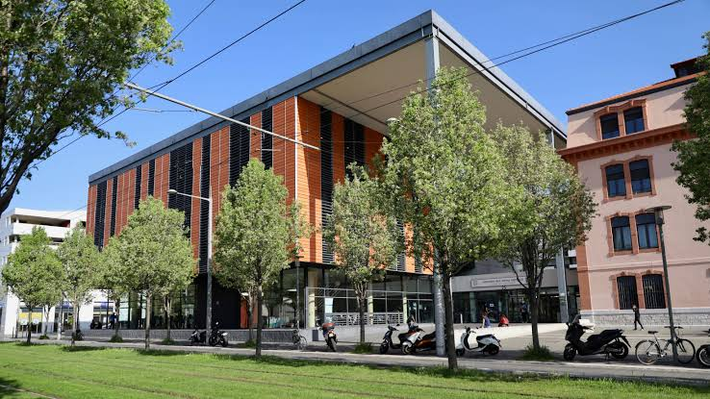
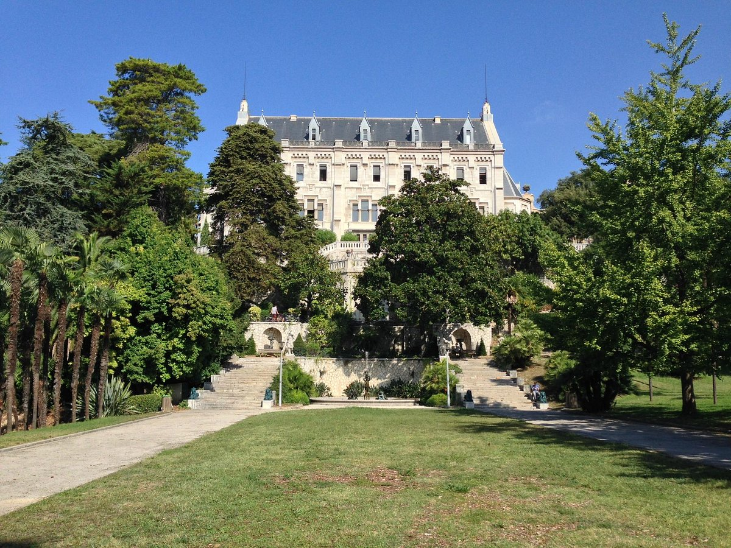
DS4H Minors
Check the content and schedule of each minor on the website!
➡️
https://ds4h.univ-cotedazur.eu/minors
Digital strategy
Innovation and design thinking
📍St Jean d'Angély campus​
IoT: Connected objects
Quantum technologies
Sensor and network devices
Website creation workshop
📍Valrose campus​
100% online
Anthropology and ethics of technics
Innovation and creativity
Emotion and AI
+ Online!

Slide 6
Focus : Agentic software development
NEW
📍 SophiaTech campus
➡️ Principles of generative agent-based AI
Different types of models, multi-agent systems
➡️ Strong emphasis on its practical use for software development
Anthropic’s Claude Code solution, key settings, best practices
➡️ Covers implementation of a RAG, MCP-interfaced agents
➡️ Mohamed Kadri (Solution Architect at Sopra Steria)
Nikan Zandian Jazi (PhD student at I3S laboratory)
➡️ Prerequesites: Python programming and Claude licence
(until September 12: https://claude.com/programs/campus)

Slide 7
Focus : Quantum computing and networking
NEW
📍 SophiaTech campus
➡️ Minor condensed into one week: workshop format!
➡️ Hands-on TPs in quantum computing, quantum programming and circuit design. Exploring some practical quantum protocols.
➡️ Implementing and testing key quantum algorithms with Python (using Qiskit from IBM, one of the most widely used quantum programming framework).
➡️ Python skills required — no prior quantum knowledge needed (basic quantum notions will be given during the classes, depending on the targeted algorythm)
➡️ Eligible for the “Quantum Aware” certificate:
https://univ-cotedazur.fr/formation/offre-de-formation/certificat-quantum-aware
📅 January 11–15, 2027

Slide 8
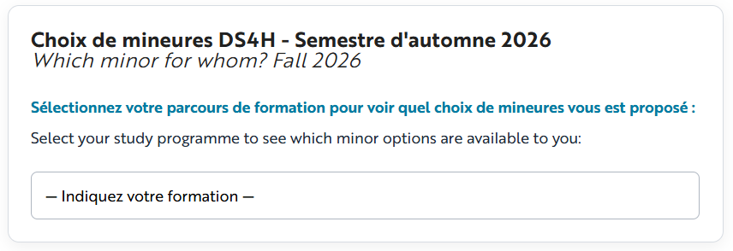
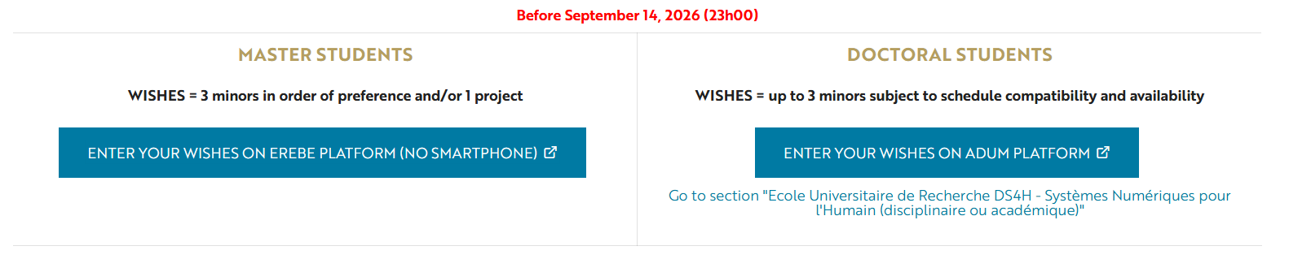
DS4H Minors
➡️
https://ds4h.univ-cotedazur.eu/wishes
Everything takes place on :

Slide 9


DS4H Projects
Take the opportunity to run individual or group projects to sharpen your professional objectives!
Research projects in tutorship
Tutorship provide training to research.
Immerse yourself in a laboratory!
Multidisciplinary research projects
Join a team of students from different disciplines working on a shared topic!
➡️
https://ds4h.univ-cotedazur.eu/education/professional-and-research-projects-1
For Master students
One per semester
Mostly on Friday
Total of
91h
💡
Download the project guide!

Slide 10
DS4H Projects
What work is expected?
Multidisciplinary research projects
1-2 pages Draft of Work / student
Progress summary.
A 25-page written report
Introduction and conclusion: jointly written by the students.
Materials and methods, results and discussion: one paragraph written by each student, highlighting the contribution of their own discipline to the multidisciplinary project.
An oral presentation
5-minute introduction and context + 10-minute presentation per student + 5-minute conclusion + 5 minutes of questions per student.
Research projects in tutorship
1-2 pages Draft of Work
Progress summary.
A 10–15-page written report
Abstract, introduction, materials and methods, results, discussion and conclusion.
An oral presentation
15-minute presentation + 10 minutes for questions.

Slide 11
DS4H Projects
Key dates
1 day per week in the laboratory, usually on Fridays, starting October 9
One week of immersion in the laboratory, from December 14 to 18
📅
➕
Deadline: 13 November 2026 – 11:00 PM on Moodle
📃
1-2 pages Draft of Work (progress summary)
Possible mid-term meeting
📁
Deadline: 4 January 2027 – 11:00 PM on Moodle
Final written report
13–15 January 2027– 8:00 AM–6:00 PM
📊
Final oral defense
Campus SophiaTech, Lucioles, room TD14 + Templiers, room F221

Slide 12
DS4H Projects
Methodology
Welcome and project methodology
📅
📍
TO BE CONFIRMED
9 or 16 October 2026, 9:00 AM–10:30 AM
Campus SophiaTech, Lucioles
Methodology : writing your report
TO BE CONFIRMED
📅
20 November 2026, 9:00 AM–11:00 AM
📍
Campus SophiaTech, Lucioles
Methodology : presenting your work
TO BE CONFIRMED
📅
11 December 2026, 9:00 AM–11:00 AM
📍
Campus SophiaTech, Lucioles
Oral defense practice session
📅
6-8 January 2027, schedule on demand
📍
Campus SophiaTech, Lucioles, room TD14

Slide 13
DS4H Projects
How to choose a project?
1️⃣ Browse the projects available on the EREBE website from your computer (no mobile phone).
➡️
https://erebe-vm6.i3s.unice.fr/eur-options/
2️⃣ Make your choice on the EREBE website from your computer (no mobile phone).
At the same time as your minor selection. Even if you are not taking a minor and/or participating in a project, you must confirm this on EREBE.
3️⃣ Immediately contact the supervisor of the project you are interested in!
Use your university email address : etu.univ-cotedazur.fr

Slide 14
DS4H Projects
How to choose a project?
4️⃣ You and the supervisor confirm your application for the project.
Send an email to ds4h-pedagogie@univ-cotedazur.fr
The DS4H team ensures that the project is approved by the programme director ("responsable de formation").
5️⃣ Send the required documents as soon as possible, and no later than October 1st!
So that a tutoring agreement (for a tutoring project) or a learning agreement (for a multidisciplinary project) can be prepared. Without these documents, you will not be able to start your project!
6️⃣ You have received your tutoring agreement or learning agreement: your project can now begin!

Slide 15
DS4H Projects
What if the supervisor does not approve my application?
1️⃣ Review the projects available on EREBE and identify the ones you are interested in.
➡️
https://erebe-vm6.i3s.unice.fr/eur-options/
2️⃣ Send an email to ds4h-pedagogie@univ-cotedazur.fr
Provide the details of the project for which your application was not selected, as well as the projects you would be interested in. We will help you find a suitable project!

Slide 16
Make your choices
NB!
Use your univ email address!
📝
Submit your minor and project wishes
➡️ https://ds4h.univ-cotedazur.eu/wishes
September 10
14h30
September 14
23h
📩 For any questions: ds4h-pedagogie@univ-cotedazur.fr
Joséphine Désert, Office 312, SophiaTech Campus, Lucioles

